Slide 1
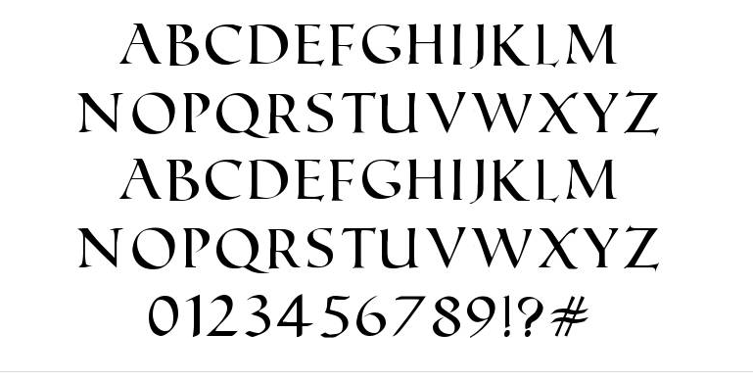




Glyph
Characters
Styles

